Slide 1
Higher education in Colombia
For the Seminar “Higher education systems in Europe and abroad” in 2015
by Kai Klinker

Slide 2
Outline
General information about Colombia
  Geography
  History
Colombian Education system
The Universidad Nacional de Colombia (UNAL)
Computer science at the UNAL
Student Life

Slide 3
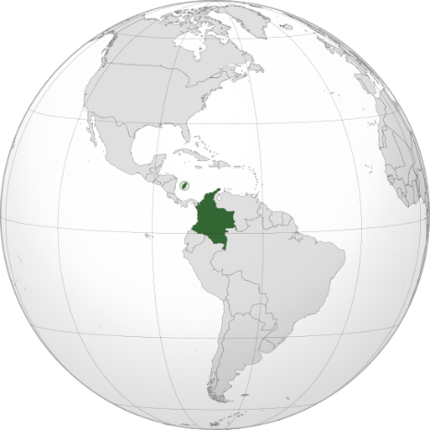
Colombia

Slide 4
Colombia
Population: About 40 Million inhabitants
Territory: 1.141.748 square kilometers (Germany has 357.168)
Official Language: Spanish
Currency: Colombian Pesos (2745 Pesos are 1 Euro 20.1.2015)
Natural resources:
  Oil and gas
  Coal
  Emeralds (80% of worldwide production)
  Nickel, gold, silver, platinum, iron ore

Slide 5
Climate
Equator passes through the south of Colombia
Does not have seasons like we do, only rain seasons
The climate depends a lot on the altitude

Slide 6
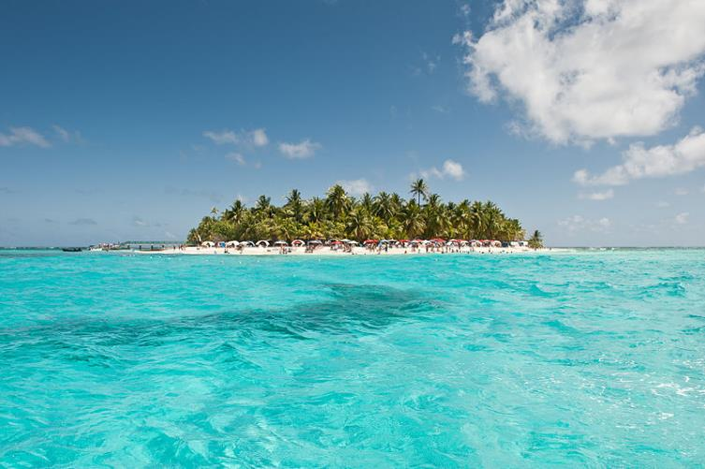
San Andres
Lies in the Caribbean sea northwest of of Colombia
Average temperature: 28 degrees Celsius

Slide 7
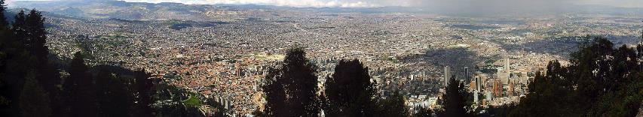
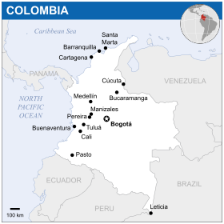
Bogota
Capital of Colombia
About 8 million inhabitants
Altitude: 2650 m
Average temperature: 13 degrees Celsius

Slide 8
Colombian History
Colonized by the Spanish in 1499
There is an ongoing armed conflict that started in the 1960s
The main participating groups are:
  Guerilla groups (FARC and ELN)
  Paramilitary groups (de-mobilized in 2001)
  Colombian military
  Crime syndicates (such as the Medellin cartel)
The conflict was the most violent in the 1990s and has cooled down since 2000.
It is estimated that about 220 000 people were killed and that 80% of the victims were non-combatant civilians.
About 6 million people have been displaced since 1985

Slide 9
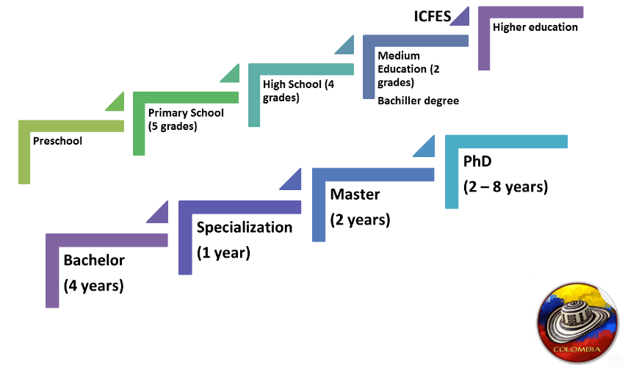
Colombian Education System

Slide 10
Academic Year and Credits
Academic year
  Summer semester: February to June (April to September in Germany)
  Winter semester: usually August to December (October to March in Germany)
  The semester can be delayed by strikes and demonstrations
Credits
  The master lasts 4 semesters
  Total amount of credits: 52
  => 1 Colombian credit ~ 120/52 ~ 2.3 ECTS

Slide 11
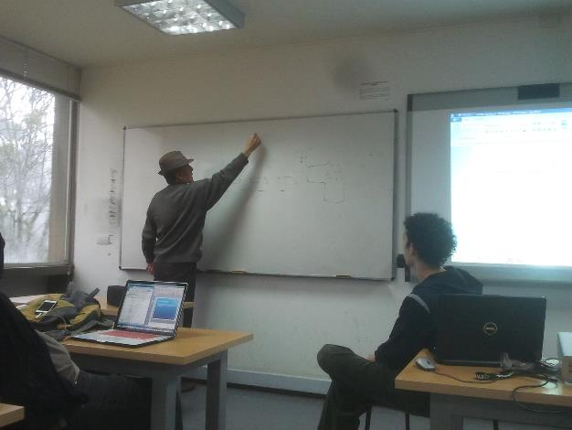
Teaching style
Very different to studying at a German university
Much more similar to school
Lectures are held in classrooms
Typical class size: 8-25 students
The professor behaves more like a teacher

Slide 12
Teaching style
The grades are gathered throughout the year by
  Homework
  Tests
  Presentations
  Software Projects
  Final projects
  Final exams
On average there was about one mark per week

Slide 13
Grading
Grades From 5 to 1
5 is the best mark and 1 the worst (inverse to our system)
The last passing grade is 3
Formula: 1+3*(5 - colombian mark)/2
Example: A 4.0 in Colombia
1+3*(5 – 4.0)/2 = 2.5
So a 4.0 in Colombia would correspond to a 2.5 in Germany

Slide 14
Universidad Nacional de Colombia (UNAL)
One of three public universities in Colombia
The amount of money students have to pay per semester depends on their parents’ income.
Is considered to be the best university in Colombia (place 316), together with the private “Universidad de los Andes” (place 262 in QS university worldwide rankings 2014)
50 000 students (TUM 37 000)
Has campuses in 8 different cities in Colombia.
94 pre-graduate programs
148 Master programs
54 doctor programs

Slide 15
Computer Science at the UNAL
Called Ingenieria de Sistemas y Computacion
Bachelor:
  5 years and a total of 165 credits
  48 credits in basic subjects (Mostly math but also economics and science)
  84 credits in basic computer science lectures
  33 credits electives
  12 credits language courses

Slide 16
Computer Science at the UNAL
Master:
  2 years and a total of 52 credits
  22 credits Master’s thesis
  4 credits Master project
  6 credits Seminars
  20 credits electives

Slide 17
Courses I took
Temas avanzados de Ingenieria de software I (advanced topics in software engineering)
  Project: We built a web application to play peg-solitaire in group of three people
  We tried to use SEMAT in the project (an agile development method like SCRUM)
Optimizacion Bio-Inspirada (Bio-inspired optimization techniques)
  We had to implement several algorithms ourselves and apply them to test problems
  Topics: Genetic algorithms, Particle Swarm Optimization, Simulated annealing and ant colony optimization

Slide 18
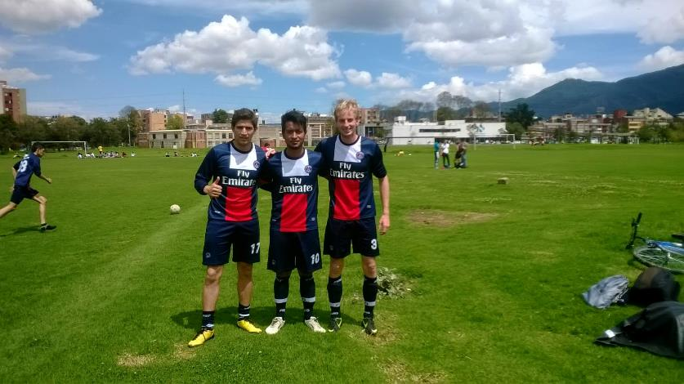
Student life
Many activities offered at the university
For example: Climbing, soccer, dancing, martial arts, yoga, gymnastics, running, American football, chess, table tennis, weight lifting, tennis, squash, futsal, basketball, frisbee
To participate you need to find the person in charge for that activity and talk to them
It is easy to find friends

Slide 19
Thank you for your attention

Slide 20
Colombian education System
Edad | Grado | Nivel Institucional
Preescolar
1-2 | Prejardín | Jardín Infantil / Educación Preescolar
2-3 | Jardín
3-4 | Preescolar
4-5 | Kínder
5-6 | Transición
Primaria
6-7 | 1° | Escuela Primaria / Educación Básica Primaria
7-8 | 2°
8-9 | 3°
9-10 | 4°
10-11 | 5°
Básica Secundaria
11-12 | 6° | Básica / Educación Básica Secundaria
12-13 | 7°
13-14 | 8°
14-15 | 9°
Alta Secundaria
15-16 | 10° | Bachillerato / Educación Media
16-17 | 11°
17-18 | 12° (Sólo en algunos colegios)
Educación Superior
18+ | Universidad | Universidad / Educación Superior

Slide 21
Colombian education System
Agrupación | Créditos obligatorios | Créditos optativos | Total de créditos exigidos
Matemáticas, Probabilidad y Estadística | 30 | 0 | 30
Ciencias Naturales | 8 | 4 | 12
Ciencias Económicas y Administrativas | 6 | 0 | 6
Total | 44 | 4 | 48

Slide 22
Colombian education System
Agrupación | Créditos obligatorios | Créditos optativos | Total de créditos exigidos
Arquitectura y Hardware de Computadores | 9 | 0 | 9
Métodos y Tecnologías de Software | 24 | 0 | 24
Infraestructura de Sistemas | 9 | 0 | 9
Sistemas de Información y Organizaciones | 6 | 0 | 6
Investigación de Operaciones | 9 | 0 | 9
Tecnologías de Aplicación | 9 | 12 | 21
Sin Agrupación (Trabajo de Grado) | 6 | 0 | 6
Total | 72 | 12 | 84

